Slide 1
Lecture 3 Formation of the Terrestrial Planets and Origin of Earth’s water
The basics of terrestrial planet formation
The origin of water
1798 engraving, Pass

Slide 2
Ice forms here
Earth forms here

Slide 3
Sources of water for the Earth: Standard Mean Ocean Water D/H=150 ppm Plausible total water to deliver ~ 10⁻³ M_{earth}
Comets—most numerous, water content 50% or larger, but three short-period comets have D/H ~ twice that of Standard Mean Ocean water (150 ppm).
Also dynamically difficult to deliver (Morbidelli et al., 2000)
Water adsorbed on solar nebula grains (Stimpfl and Drake, 2006): timing issues, D/H unknown.
Chondrite parent bodies: D/H ~ SMOW
Carbonaceous chondrites: > 2.5 AU, water ~ 1-10%, require 1-10% of the Earth to be accreted from carbonaceous chondrite embryos
Ordinary chondrites: 2-2.5 AU, water ~ 0.3-3%, require 3-30% of Earth to be accreted from ordinary chondrite embryos
Enstatite chondrites: 1.5-2 AU, water < 0.1%. Too dry.

Slide 4
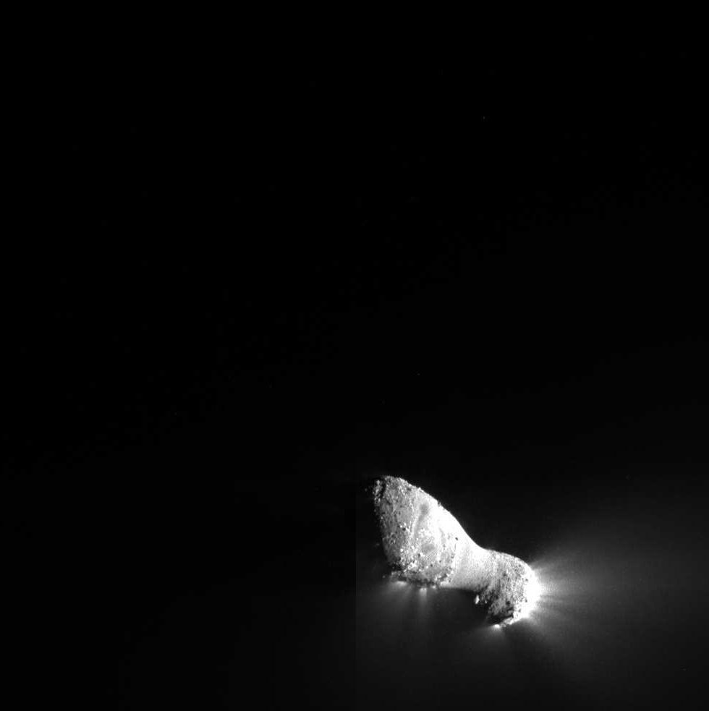
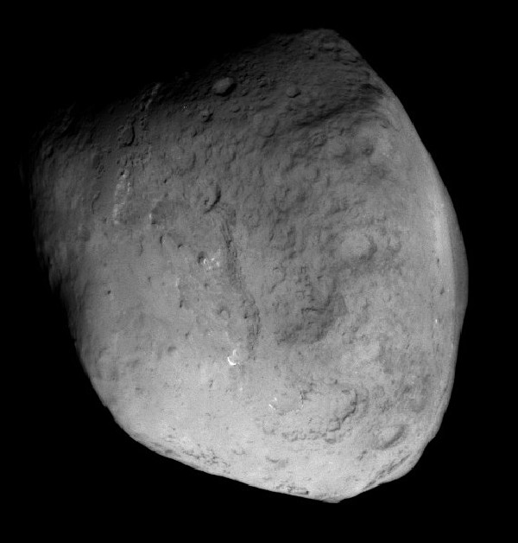
Stardust Tempel 2
Epoxi Hartley

Slide 5
Waite et al., 2009

Slide 7
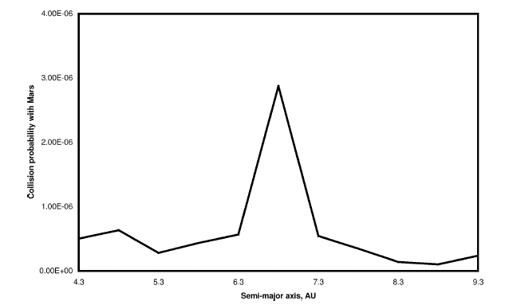
Why comets (from the traditional source regions) do not work.
Comets have been historically cited as “the” source of Earth’s water. But they have two problems.
Dynamics of bodies outward of Jupiter: probability of impact with the Earth is too small.
D/H ratio is too high (next slide).
Both considerations lead to conclusion that comets provided no more than 10% of Earth’s water.
1/2 ocean
Collision probability
4 5 6 7 8 9
Semi-major axis, AU

Slide 8
D/H rules out comets as a primary source of Earth’s water—so do the dynamical calculations

Slide 9
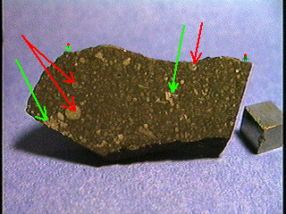
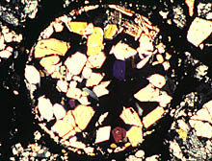
Chondrites: meteorites with inclusions called chondrules

Slide 10
0
Putative parent body (p.b.) locations and water content at the time of the Earth’s growth
-1
Log₁₀(Water mass fraction)
-2
Carbonaceous
Ordinary
-3
Earth’s water content
Dry
Enstatite
-4
0.3 1.5 2.0 2.5 3.0 4.0
Distance from the Sun, AU

Slide 11
Scenario for Terrestrial Planet Formation
(see Goldreich, Lithwick, Sari 2004; with modif.)
Runaway accretion in a disk of small bodies: <10⁶ years (1)
--terminates when separation exceeds width of feeding zones (Safranov, Hayashi)
‘Oligarchic’ growth period in which embryos grew at expense of smaller bodies: 10⁵-10⁶ years
--largest bodies grow in lockstep; small bodies shrink (Kokubo and Ida)
Orbits of embryos begin to cross: 10⁸ years (2)
--inner solar system: embryos collide and coalesce to > Earth-sized (3)
--outer solar system: random velocities of some embryos rise until they are ejected
Cleanup of small bodies: few x 10⁸ years (inner solar system); > 10⁹ years (outer solar system)
--Inner solar system: ~ all material in the small bodies ended up in planets
--Outer solar system: most > kilometer-sized bodies ejected
(1) Process might be “delayed” by 10⁶-10⁷ yrs by migrating Jupiters in gas disk (Lin, Papaloizou)
(2) Growth of Jupiter speeds up or enables growth of embryos to Earth-sized (Chambers)
(3) Presence of residual gas may interrupt or slow growth from Mars-sized (Kominami and Ida)

Slide 13
2b

Slide 14
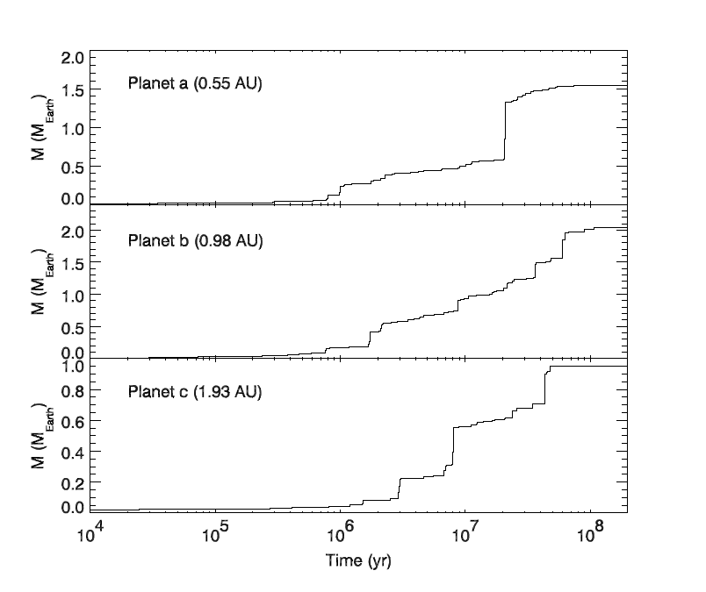
The timescales in the dynamical simulations are correct
Raymond et al, 2006

Slide 15
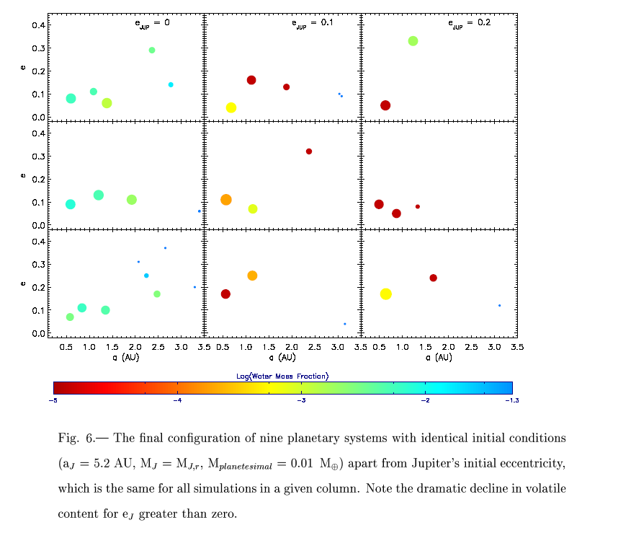

Slide 16
Problem
The Earth is not a carbonaceous chondrite.
Even 1% carbonaceous, by some reckonings, is too much.
Need to consider other material that was in the asteroid belt but is no longer.

Slide 17
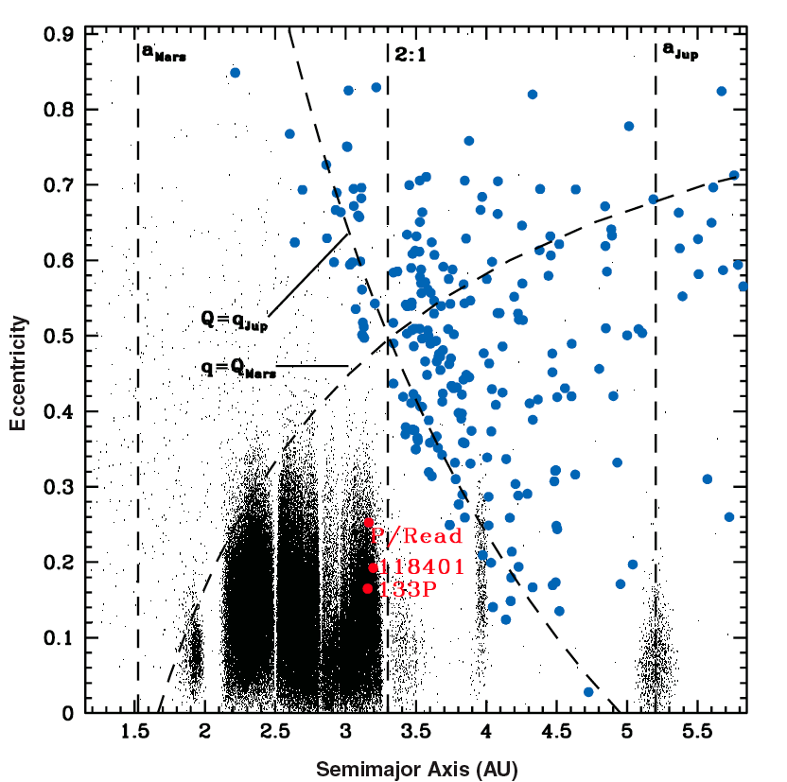
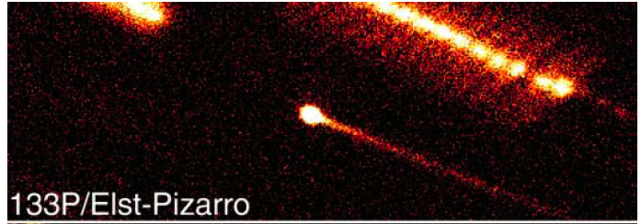
Back to the question of water…
Five bodies in the asteroid belt today: “main belt comets” might be avatars of the most important contributor to Earth’s water.
Hsieh and Jewitt, 2006

Slide 18
0
MB Comet
Putative parent body (p.b.) locations and water content at the time of the Earth’s growth
-1
Log₁₀(Water mass fraction)
-2
Carbonaceous
Ordinary
-3
Earth’s water content
Dry
Enstatite
-4
0.3 1.5 2.0 2.5 3.0 4.0
Distance from the Sun, AU

Slide 19
Hansen, Morbidelli, Walsh, O’Brien...
Science News figure

Slide 20
Chemi-sorption of water on silicate grains at 1 AU: Makes water stable in the structure at high temperatures
Vattuone et al. 2010
Science News figure

Slide 21
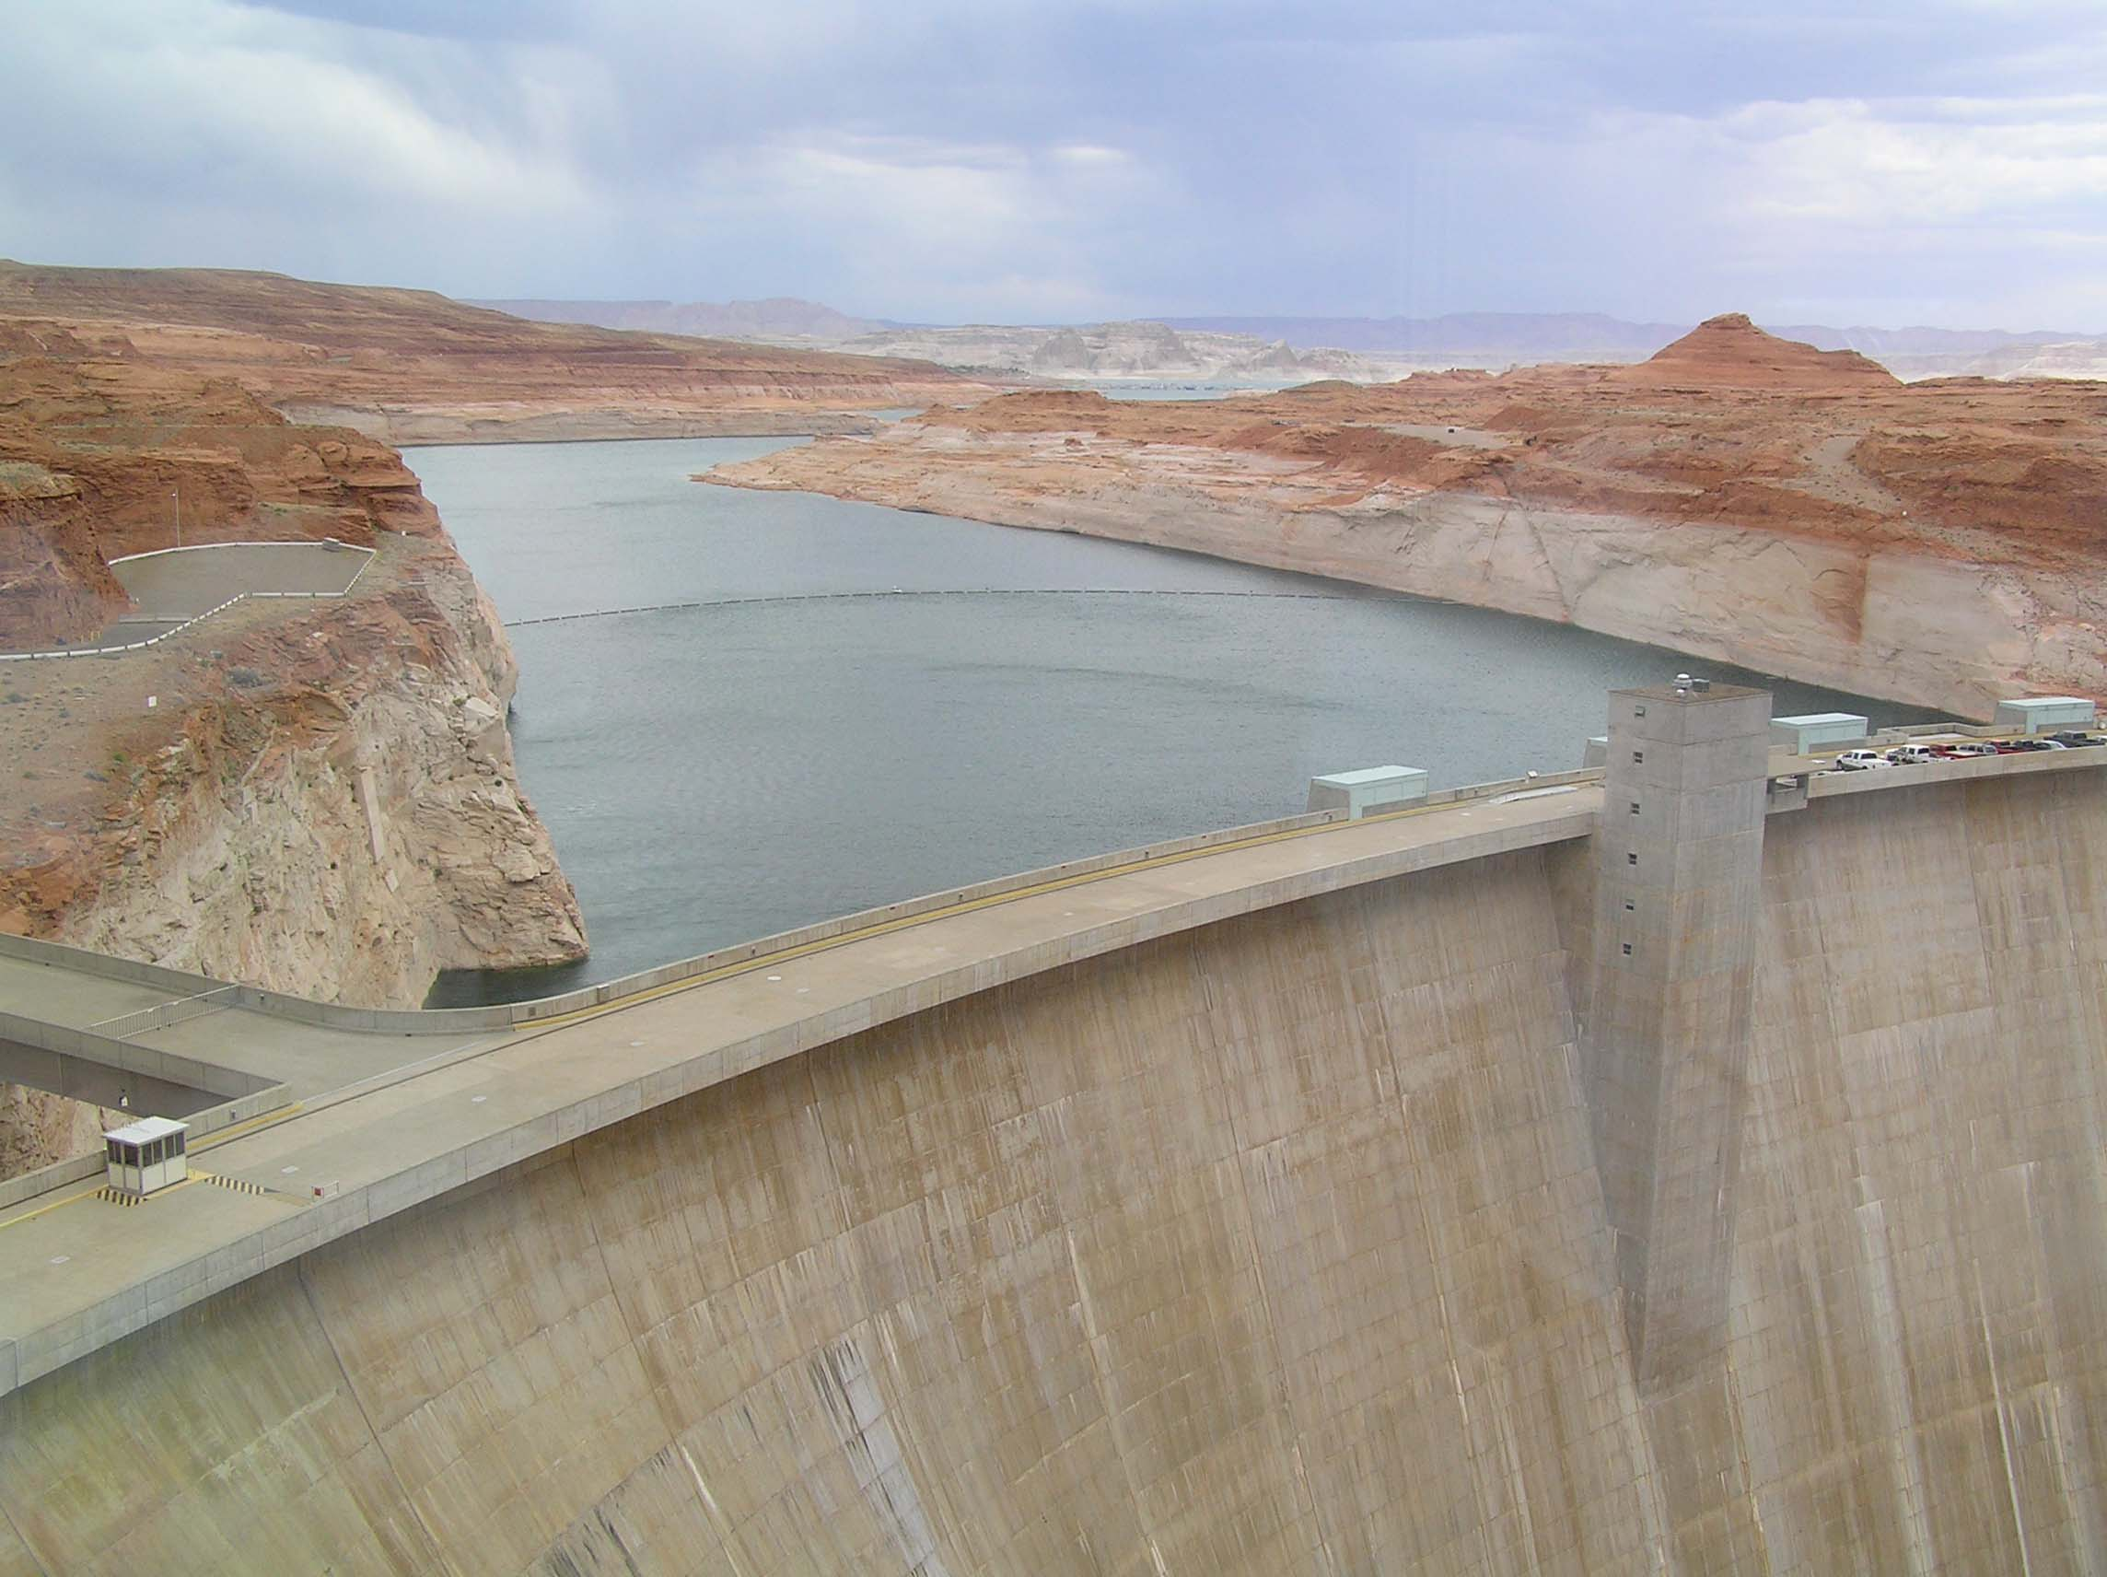
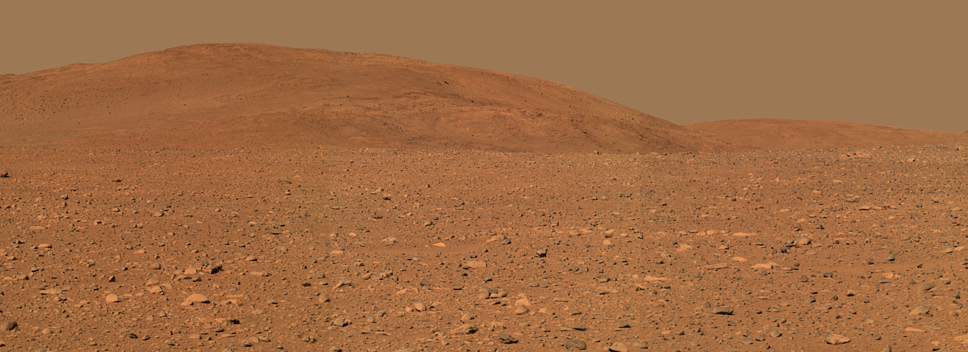
Conclusions
Terrestrial planet formation postdated giant planet formation
Source of Earth’s water is uncertain but is not part of any meteorite collection
Was water local or imported? This is key to understanding how common is a well-watered Earth at 1 AU.

