Slide 1
Lecture 8
Extrasolar planets detection methods and strategy

Slide 2
Techniques
Radial velocity
Transit
Astrometry
Microlensing
Direct

Slide 3
Brown Dwarfs
Planets
~ 530 planets to date:
Notes:
Figure 1 Mass versus semimajor axis for all known objects in the mass range from 10⁻⁴ to 100 M_{J} in orbit around nearby stars or brown dwarfs. Data were compiled from exoplanet.eu, Burgasser et al. (2007) and vlmbinaries.org. Data are represented in four different versions of axis scaling to emphasize different aspects of the parameter space. The yellow region indicates the only region that is clearly devoid of objects based on sensitivities of various surveys. The green region is almost entirely unobserved except in a few cases for extremely young objects (and the Solar System). The gray regions show roughly where direct imaging surveys have placed some constraints on this parameter space, with darkness qualitatively representing completeness

Slide 4
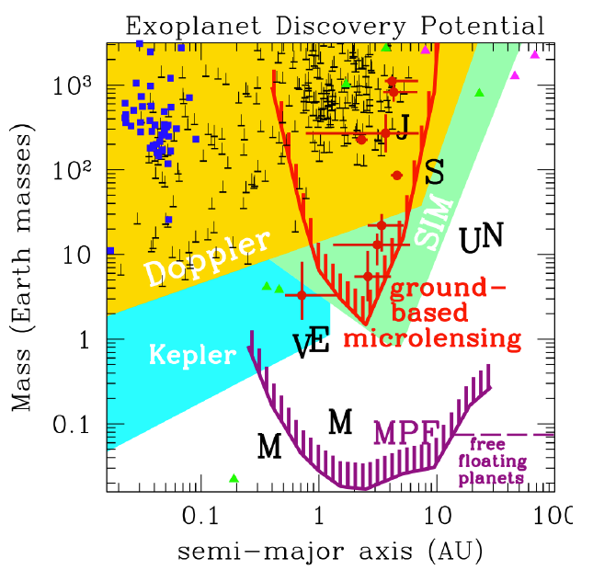
Space-based photometry is more precise than ground-based
David Bennett

Slide 5
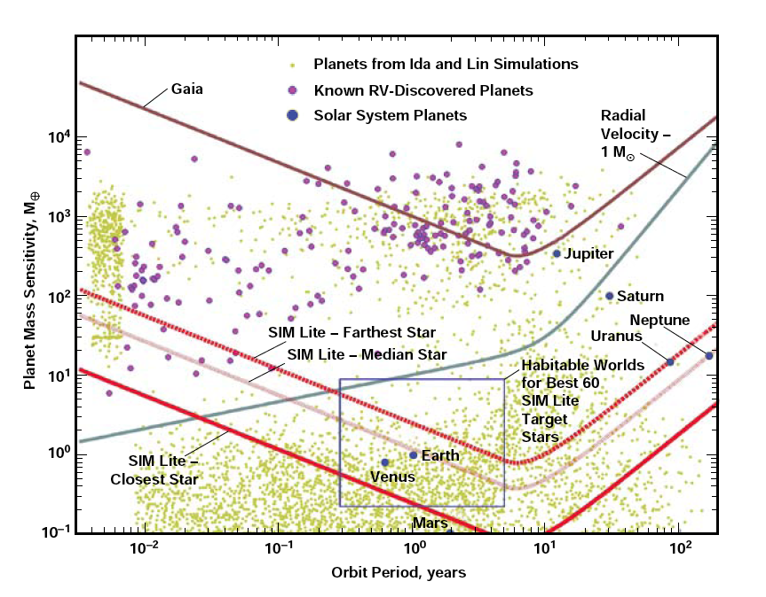
Radial Velocity—1 m/s

Slide 6
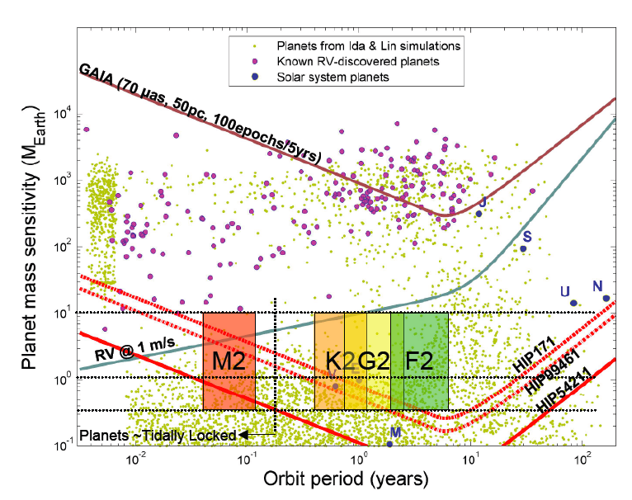

Slide 7
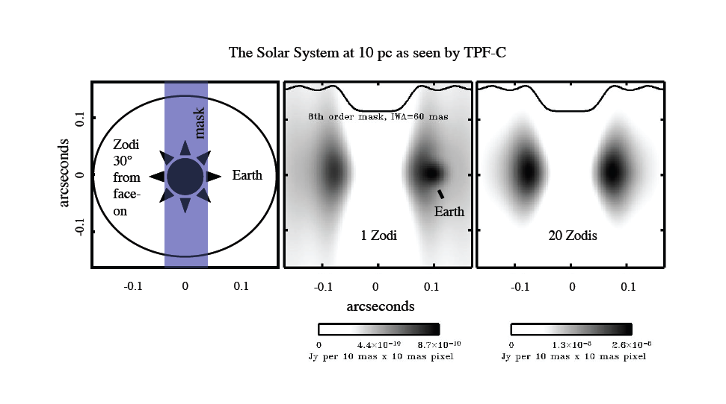
Marc Kuchner

Slide 8
Exoplanet Task Force 2008: A two-pronged strategy
M dwarfs
Fast-track
ground-based, and existing space assets
1-5 yrs
5-10 yrs
10-15 yrs
F, G, K dwarfs
Requires technology investments
And new space-based facilities

Slide 9
If η⊕ is > 0.1 and Exozodi < 10 Zodi
η⊕,masses, addresses Density, Characterize
M dwarfs
RV + Transit surveys+SIRTF → JWST
1-5 yrs
6-10 yrs
11-15 yrs
Radial velocity Space Astrometry
F, G, K dwarfs
Corot / Kepler → Space Microlensing → Space Direct Imaging
η⊕ @< 1 ΑU
η⊕ @ 1−10ΑU
Characterize for habitability
← Techn development & exo-Zodi for direct detection missions →

Slide 10
Why obtain the mass of a planet?

Slide 11
Densities of the planets
Mercury 5.43 (water = 1 g/cc)
Venus 5.25
Earth 5.52
Jupiter 1.33
Saturn 0.71
Moon/Europa 3.0
Icy Moons 1-2.
Ice = 0.9-1.
Slicates=2-4
Iron=7-8

Slide 12
M
Degenerate regime
Ideal regime
“Normal” matter with finite compressibility (Coulomb interactions) and thermal presssure
Pressure is only increased by the mass of the particles which increases gravity, thus pulling the particles closer together. Mass increases→ the pressure is increased, and the particles become spaced closer together.
R
R_{max}

Slide 13
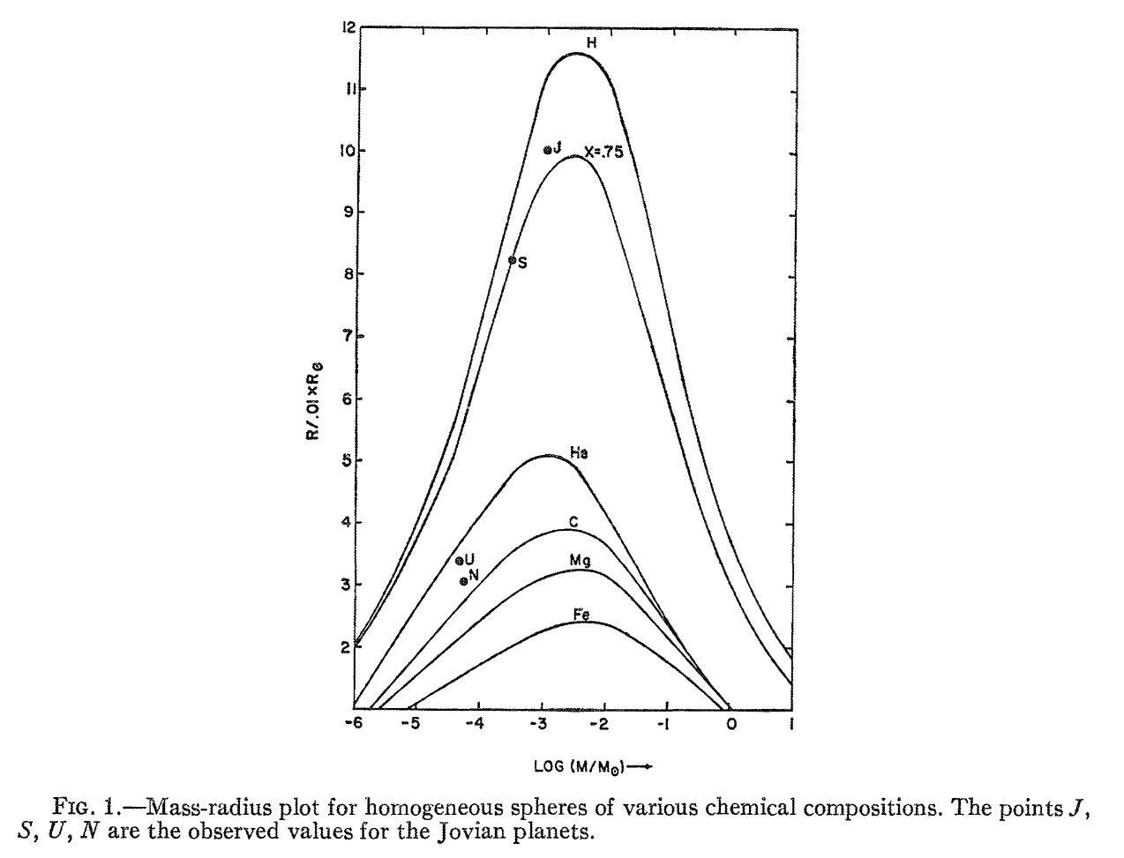
Zapolsky and Salpeter

Slide 14
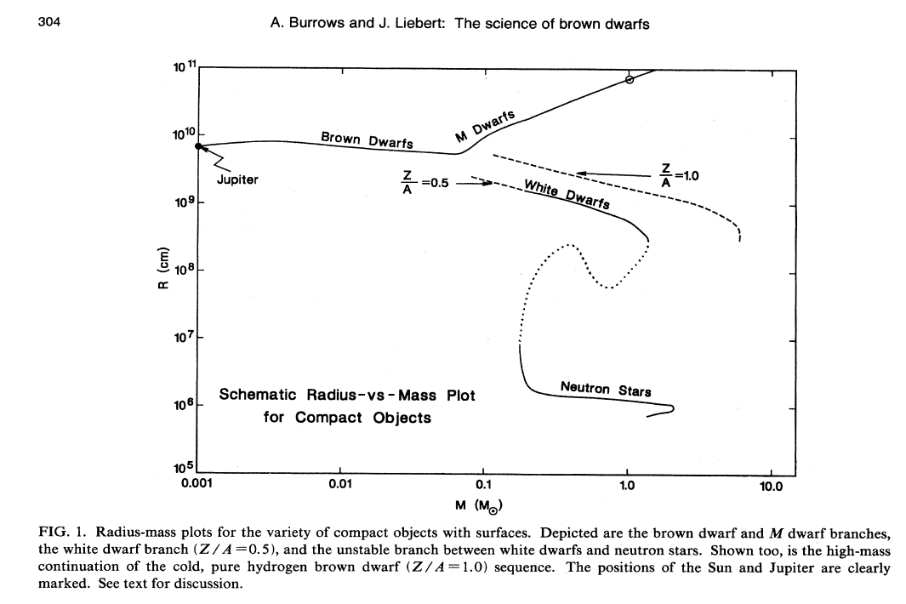

Slide 15
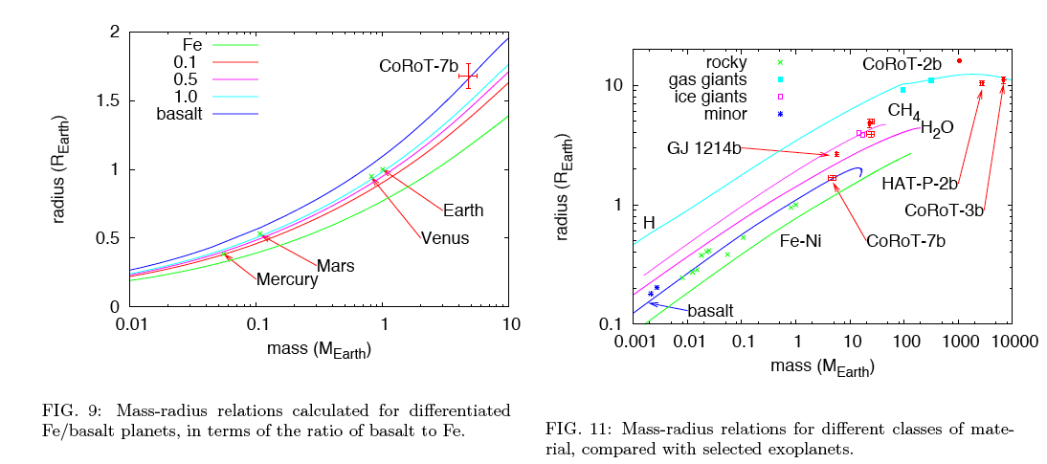
Swift et al., Exoplanets (ed Seager, UA Press)

Slide 16
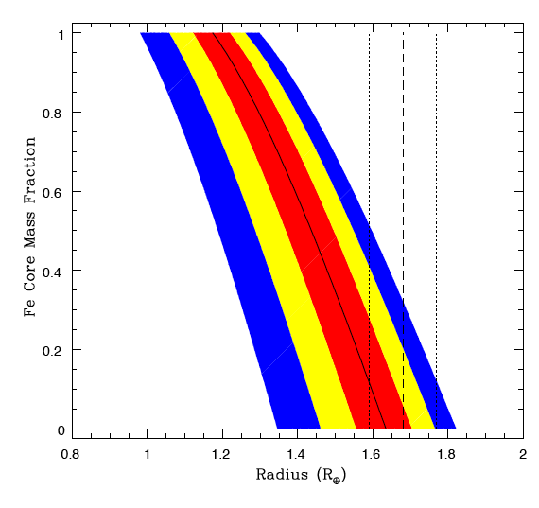

Slide 17
For radial velocity detections in multiple planet systems, an upper limit to the masses of the bodies is obtained by dynamical stability arguments.

Slide 18
Raw data from Kepler 11. Colored dots correspond to planets. (a) is raw, and (b) processed.
Lissauer et al Nature 2011

Slide 19
Transit timing variations→ masses

Slide 20
Kepler 11 system
Lissauer et al Nature 2011

Slide 21
Do we really need the mass if we can directly image the planet?
Consider the radius(R) –albedo(A) ambiguity:
Reflected (optical) brightness goes as A R²
Infrared emission goes as (1-A) R²
With one or the other we cannot determine the radius. Need two missions or the ability to spatially resolve the disk.
It is doubtful that we will fly two direct imaging missions or one that can resolve the disk in any reasonable planning horizon.
Color concept (Traub): Broadband colors for each of the solar system’s planets are distinct—diagnose terrestrial vs gas giant? But: “There are more kinds of Earths in the heavens, Horatio, than are dreamt of in your philosophy...”

Slide 23
If η⊕ is > 0.1 and Exozodi < 10 Zodi
η⊕,masses, addresses Density, Characterize
M dwarfs
RV + Transit surveys+SIRTF → JWST
1-5 yrs
6-10 yrs
11-15 yrs
Radial velocity Hi-precision RV
F, G, K dwarfs
Corot / Kepler → Microlensing → Space Direct Imaging
η⊕ @< 1 ΑU
η⊕ @ 1−10ΑU
Characterize for habitability
← Techn development & exo-Zodi for direct detection missions →

Slide 24
Radial Velocity—1 m/s
Radial Velocity—0.1 m/s

Slide 25
General consensus of the experts here is that 10 cm/s is instrumentally achievable but there may be only a small number of G dwarfs sufficiently quiet to take advantage of this capability

Slide 26
Borucki et al. 2011
η⊕ = 0.05 but completeness falls off dramatically for >0.1 AU

Slide 28
Conclusions
Mass is an essential parameter in addition to radius. Strategies should not be designed around direct detection spectrometry/photometry only.
RV may be the primary technique for finding masses of Earth-like bodies in nearby systems. Because the number of systems will be small, statistics cannot be used to constrain sine (orbit inclination), hence derived planet masses and densities will be lower limits.
It is unclear right now whether Earth mass bodies in the Habitable Zone are sufficiently common for the “cheap TPF” strategy to apply. May need space-based microlensing to sort this out. NASA and ESA need to cooperate on this.

