Slide 1
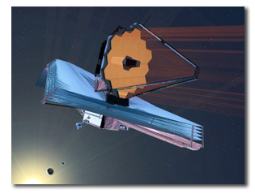
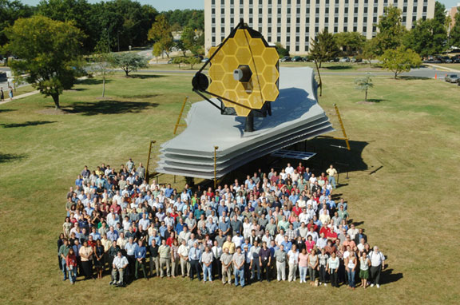
Over 1000 people in more than 17 countries are developing the James Webb Space Telescope. Shown here are team members in front of the JWST full-scale model at the Goddard Space Flight Center in Greenbelt, Maryland.

Slide 2
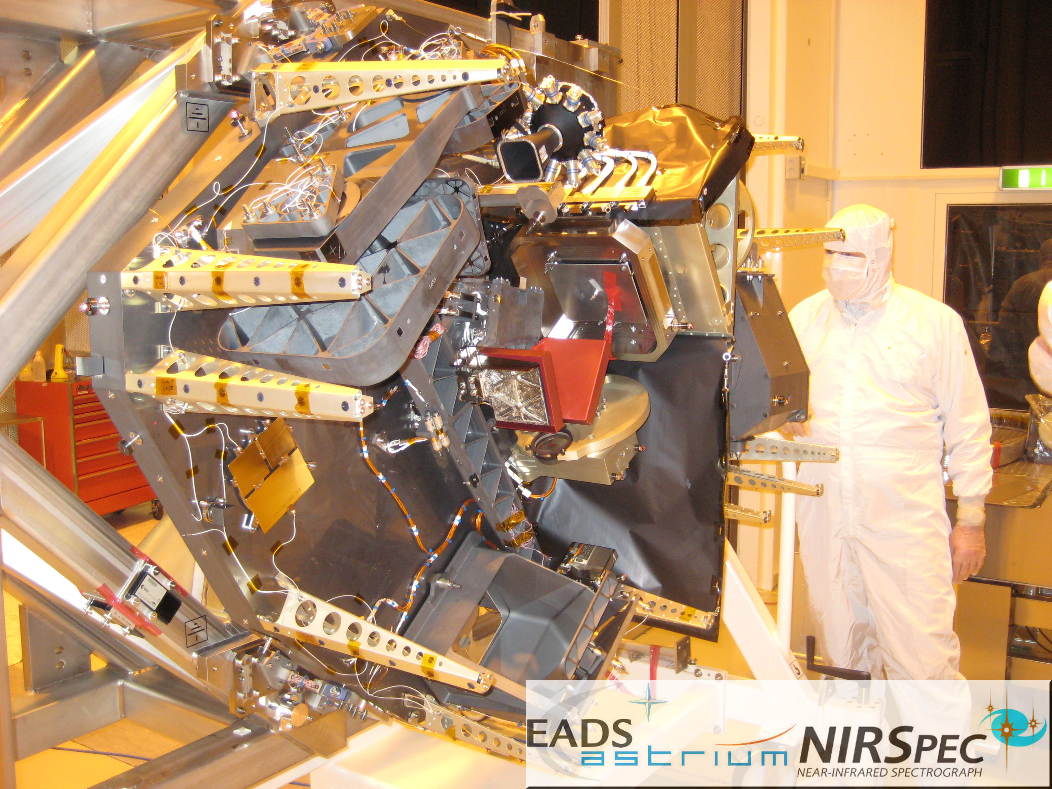

Slide 4
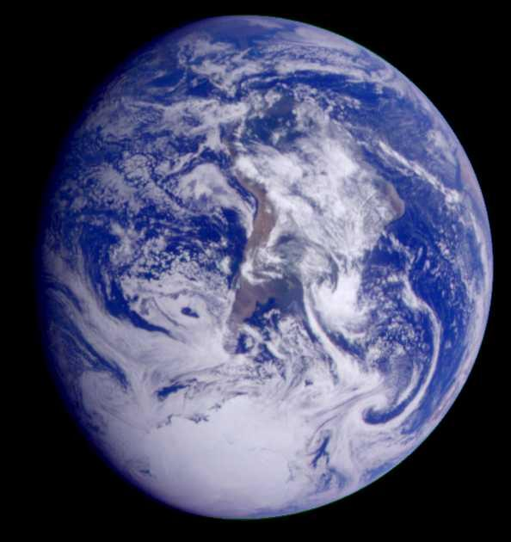
G V
T_{eff} 258K
0.1 AU 1 AU 10 AU
M V
T_{eff} 258K

Slide 5
Seager et al. 0808.1913 Astro-ph

Slide 6
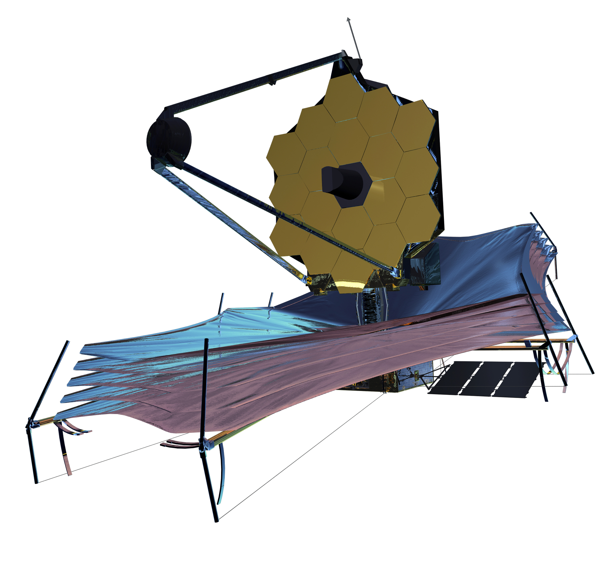
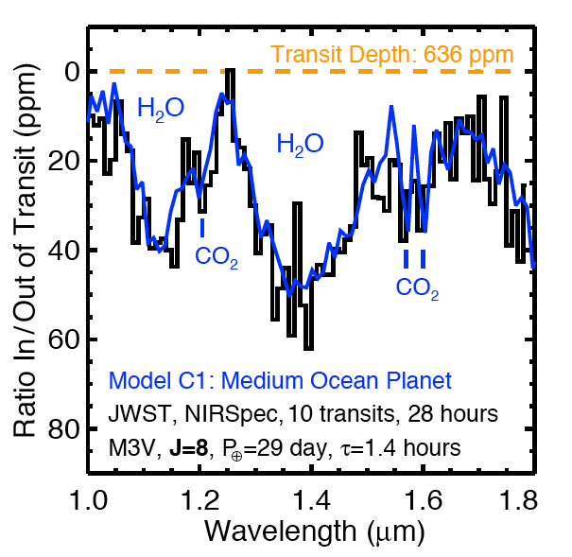
JWST transit of an Earth-sized, ocean-covered world
Valenti et al 2007

Slide 7
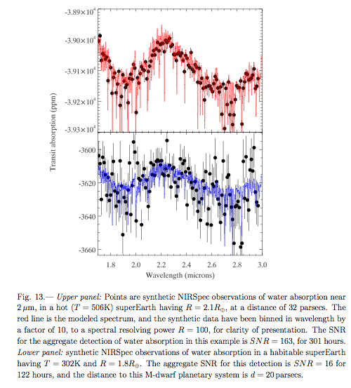
Deming et al 2010

Slide 8
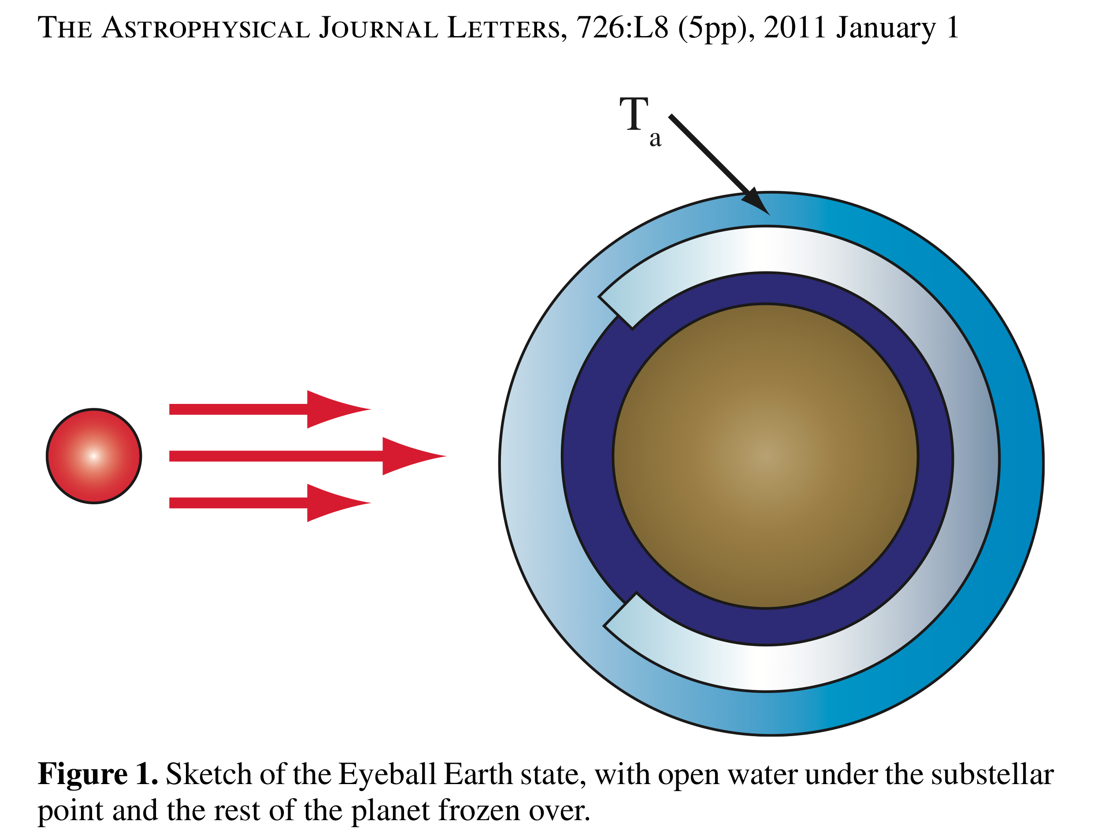
Gliese 581g
Pierrehumbert et al 2011

Slide 9
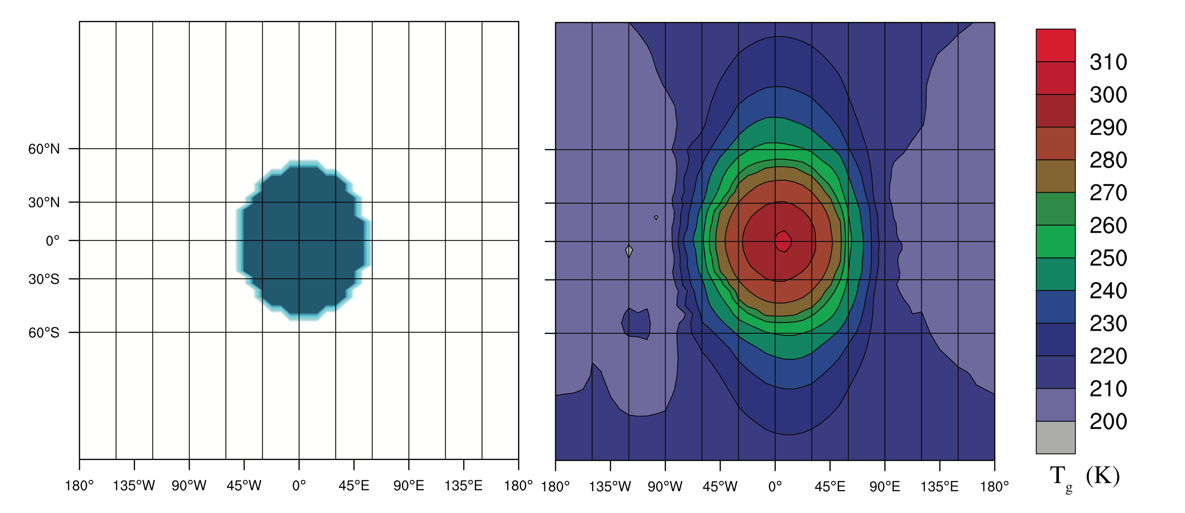
Pierrehumbert et al 2011

Slide 10
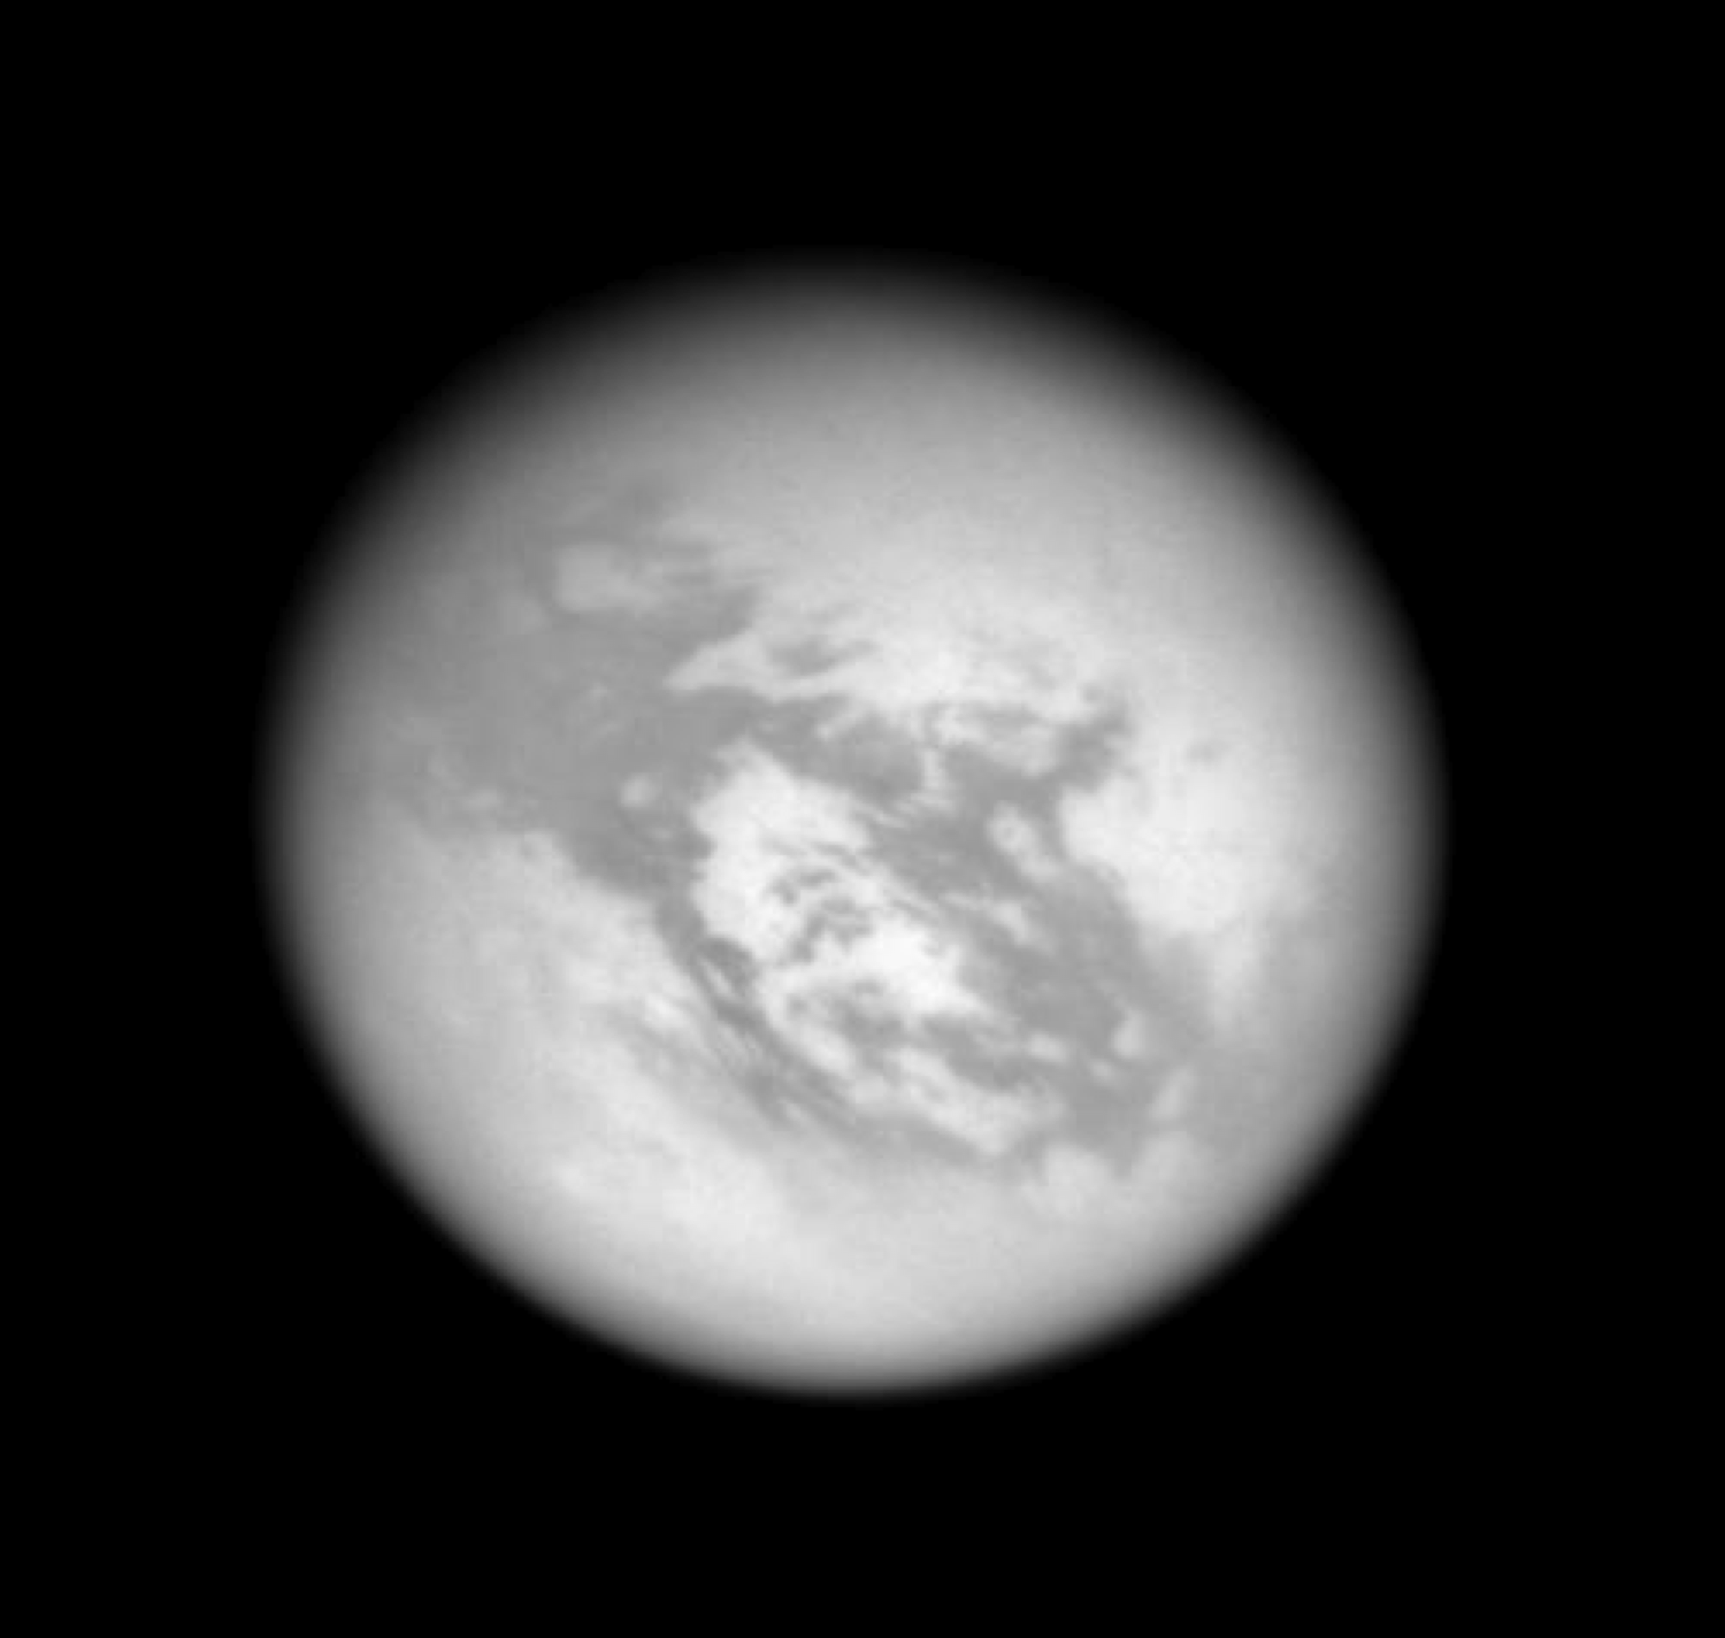
T_{eff} 258K 85K
G V
0.1 AU 1 AU 10 AU
M V
T_{eff} 258K 85K
Life in Titan seas → a second habitable zone?

Slide 11
Gilliam and McKay

Slide 12
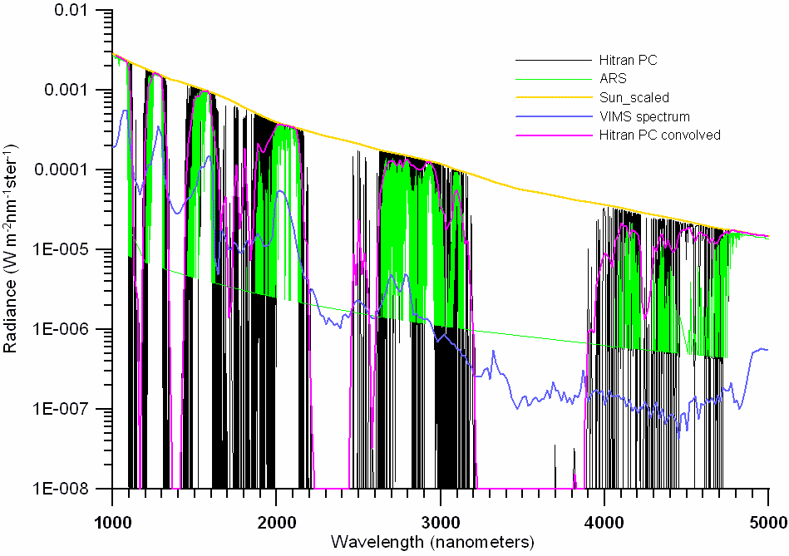
Titan
Celleti et al.

Slide 13
Titan’s atmosphere
NB – 1D radiative transfer codes are able to produce matching temperature profiles by including what we know about Titan’s composition

Slide 14
Gilliam and McKay

Slide 15
The methane “habitable zone”
Situated at 1 AU—a quiescent region—avoiding the region of flares and tidal locking around M dwarfs.
Methane hydrologic cycles may be more common than “water” hydrologic cycles in the cosmos.
M dwarfs are the most common stars in the cosmos—Titan might be the most common type of “habitable” planet*.
M-dwarfs stay on the main sequence for longer than the age of universe…plenty of time for “slow” development of “life”
An observable Titan would need to be the size of the Earth→ larger contribution from internal heat flow by a factor of ~5-10.

Slide 16
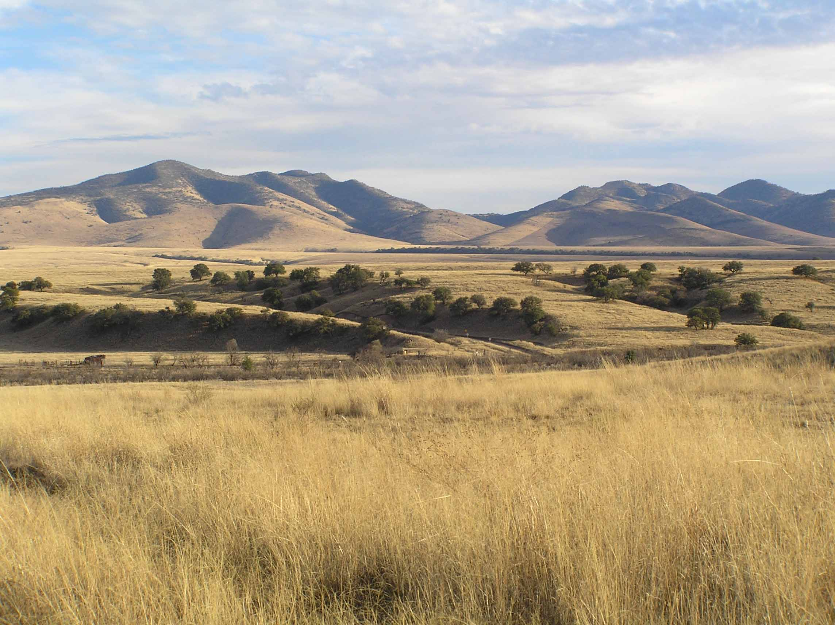
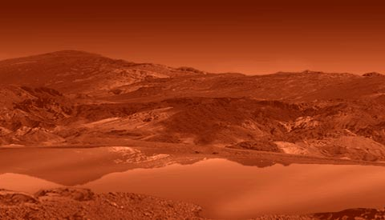
No matter which is your hab zone...
....may your search for life be a fruitful one!

